Slide 1
LOGISTIC REGRESSION PROJECT ON MEDICAL DISEASE DIAGNOSIS
Prepared by Farooq Shaikh
Under The Guidance of
Rithik Raj
Imarticus Learning, Thane

Slide 2
Introduction :
Polycystic Ovary Syndrome (PCOS) is a common endocrine disorder that affects people with ovaries, often leading to irregular menstrual cycles, hormonal imbalances, and a range of health-related issues.
Early detection and intervention for PCOS are essential for improving the quality of life for those affected.
In this project, the aim is to develop a predictive model for PCOS using logistic regression analysis.

Slide 3
Dataset :
Our dataset is sourced from Kaggle, specifically the "Polycystic Ovary Syndrome (PCOS) Data" dataset. We will be using the "PCOS_data_without_infertility" subset of this dataset.
This dataset includes various attributes related to individuals' health and demographics, with a focus on identifying factors associated with PCOS.
Our target variable, "PCOS (Y/N)," is binary and indicates whether an individual has PCOS or not.

Slide 4
Literature Survey :
During the execution of solution, we found following websites relevant to our proposed system :
https://www.projectpro.io/article/machine-learning-regression-projects-ideas/501
https://www.kaggle.com/datasets/prasoonkottarathil/polycystic-ovary-syndrome-pcos
https://www.kaggle.com/code/csanskriti/pcos-detection-using-logistic-regression-and-eda

Slide 5
Data Exploration
Data exploration is an important step in any machine learning project, including one for logistic regression.
It helps you understand your dataset, identify patterns, and prepare the data for modeling.
Data exploration steps includes importing the libraries, loading the dataset and initial data examination.

Slide 6
Data Preprocessing
Data preprocessing is a crucial step in preparing your dataset for logistic regression modeling.
It involves cleaning, transforming, and encoding the data so that it can be used effectively for training and testing your logistic regression model.
In this step we have handled missing values, encoded categorical variables, and performed necessary feature scaling.

Slide 7
Model Building
We have build a logistic regression model to predict the likelihood of an individual having PCOS based on the available features.
Logistic regression is particularly well-suited for binary classification tasks like this one.
In this project, logistic regression is helpful to classify whether a person may have PCOS or not.

Slide 8
Model Evaluation
In this project, we have assessed the performance of our logistic regression model using relevant evaluation metrics such as accuracy, precision, recall, F1-score, and ROC curve analysis.
Accuracy is the proportion of correct predictions over total predictions.
Precision measures how good our model is when the prediction is positive.
Recall measures how good our model is at correctly predicting positive classes.
F1 score is a machine learning evaluation metric that measures a model's accuracy. It combines the precision and recall scores of a model.
The ROC AUC score tells us how efficient the model is.

Slide 9
Interpretation
Interpreting involves understanding the relationships between the predictor variables (features) and the target variable, which is typically binary (0 or 1) in logistic regression.
The goal is to assess how changes in the predictor variables affect the likelihood of the binary outcome.
We have interpreted the coefficients of the logistic regression model to understand the influence of each feature on the likelihood of having PCOS.

Slide 10
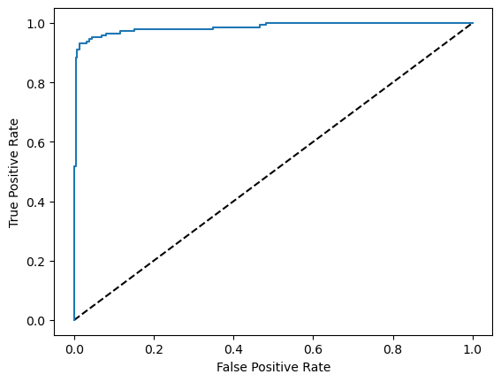
ROC Curve

Slide 11
Conclusion
In conclusion, the logistic regression model developed on the "PCOS_data_without_infertility" dataset provides valuable insights into the factors associated with PCOS.
Identified significant predictor variables that strongly influence the likelihood of having PCOS.
Evaluated the logistic regression model's performance using appropriate metrics such as accuracy, precision, recall, F1-score, and ROC-AUC.

Slide 12
References
https://www.projectpro.io/article/machine-learning-regression-projects-ideas/501
https://www.kaggle.com/datasets/prasoonkottarathil/polycystic-ovary-syndrome-pcos
https://www.kaggle.com/code/csanskriti/pcos-detection-using-logistic-regression-and-eda

Slide 13
Thank You

